Slide 1


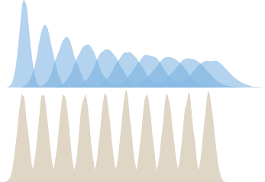
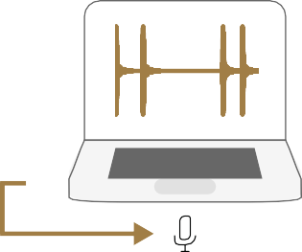

Are all control conditions in rhythm experiments equivalent?
Humans extract regularity from ‘random’ sequences
Jelle van der Werff^{1,2}, Tommaso Tufarelli^{3,4}, Laura Verga^{2,5}, & Andrea Ravignani^{1,2,6}
Department of Human Neuroscience, Faculty of Medicine and Dentistry, Sapienza University of Rome, Rome, Italy
Comparative Bioacoustics Group, Max Planck Institute for Psycholinguistics, Nijmegen, The Netherlands
School of Mathematical Sciences, University of Nottingham, United Kingdom
Centre for the Mathematics and Theoretical Physics of Quantum Non-Equilibrium Systems, University of Nottingham, United Kingdom
Department of Neuropsychology and Psychopharmacology, Maastricht University, The Netherlands
Center for Music in the Brain, Aarhus University, Denmark
How unpredictable are ‘random’ control sequences used in rhythm experiments?
Two ways of creating ‘random’ timing:
Humans are keen pattern-seekers, also in audition.
It is common in experiments to use ‘randomly timed’ sequences of stimuli as a control condition, often to provide a contrast with temporal regularity (e.g. a rhythm or a metronome).
1. (Interval) sampling
Interval_{i} = t + v_{i}
There are two ways of creating randomly timed sequences:
2. (Onset) jittering
Interval sampling: We randomly sample the intervals between events (e.g. sounds) from a normal/uniform distribution
Onset jittering: We start with a regular sequence and we randomly jitter (displace/perturb) the events a little to the left or to the right. The amount of displacement is sampled from a normal/uniform distribution
Interval_{i} = t + w_{i+1} - w_{i}
w_{i}
^{w}i+1
What mathematical differences are there between ‘sampling’ and ‘jittering’?
Autocorrelation of intervals (Pearson’s r)
1.0
(Interval) sampling
(Onset) jittering
The intervals between sounds show the exact same distribution for both methods: no difference there.
Interval duration
0.5
Sequences created using the interval sampling method have more variable duration in total. For onset jittering, the total duration of the sequence is more predictable (probably why people like this method).
0.0
−0.5
0 1 2 3 4 5
Lag
Importantly, onset jittering results in correlated intervals
(negative lag-one autocorrelation).
Distributions of sounds’ onsets
0 1 2 3 4 5
Are humans sensitive to the autocorrelated intervals in jittered sequences?
^{log e}tempo
4.0
120
4.4
Participants (n = 135) tried to tap their finger, as best as they could, together with randomly timed sounds. Ran- dom timing was created with the interval sampling or onset jittering method.
3.8
^{SD}ITI
100
log Δ_{sync}
4.3
3.6
4.2
Onset jittering: participants tap closer to the sequence tempo (e_{tempo})
Onset jittering: participants tap more regularly (lower SD_{ITI})
Participants did not tap more accurately (i.e. closer to the stimulus onsets, Δsync)
80
4.1
3.4
Sampling
Jittering
Sampling
Jittering
4.0
Sampling
Jittering
Participants are indeed sensitive to the autocorrelated intervals.
They regularize the random sequences, and can do so better for jittered sequences.
We should stop using onset jittering,
interval sampling is more random to the human ear.
Slow, less variance, long Slow, less variance, short
Condition
Slow, more variance, long Slow, more variance, short
Fast, less variance, long Fast, less variance, short
Fast, more variance, long Fast, more variance, short
Can we model why humans perform better for jittering? And why should we care?
Optimal
Equal weights
We modelled how, based on the durations of the intervals between sounds, participants might estimate the tempo of a whole sequence. The tempo is the average duration of the intervals.
Error in tempo estimation
0.75
Three potential strategies:
0.50
Mathematically ‘optimal’, with infinite memory
‘Equal weights’ for experienced interval, memory = 5 intervals
‘Exponential decay’, i.e. a recency effect for newly experienced intervals. Here, memory has a half-life of one second
0.25
0.00
Exponential decay
Tapping results
0.75
In all scenarios, the amount of error in estimating the tempo is lower for jittering, same as in our tapping results. The difference appears after only 2/3 intervals!
0.50
Even from very irregular sequences, people can extract regularity.
0.25
0.00
2 3 4 5 6 7 8 9 22
Interval_{N}
2 3 4 5 6 7 8 9 22
Rhythm is in everything, humans entrain to anything

